Slide 1
Lecture 19
Properties and PASTA

Slide 2
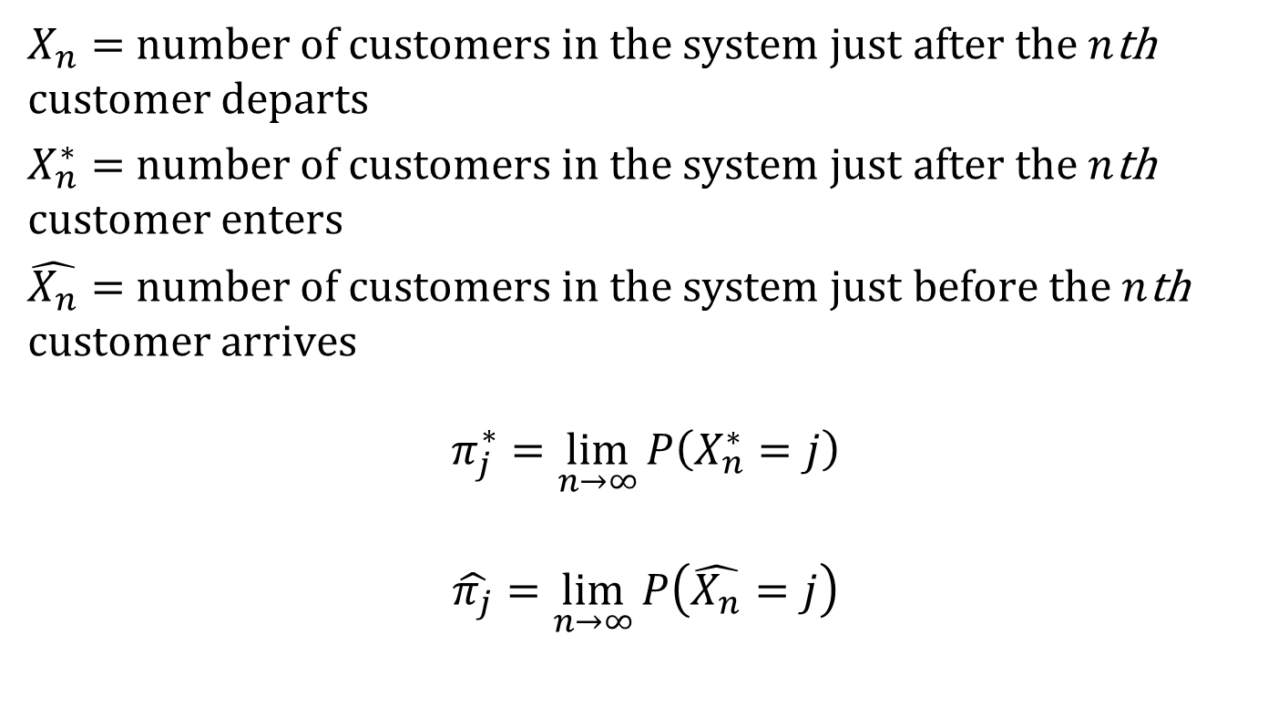
Properties of General Queuing Systems
$X_{n}=$ number of customers in the system just after the $n$th customer departs
$X_{n}^{∗}=$ number of customers in the system just after the $n$th customer enters
$\hat{X_{n}}=$ number of customers in the system just before the $n$th customer arrives
$$π_{j}^{∗}=\lim_{n→∞}{P\left(X_{n}^{∗}=j\right)}$$
$$\hat{π_{j}}=\lim_{n→∞}{P\left(\hat{X_{n}}=j\right)}$$

Slide 3
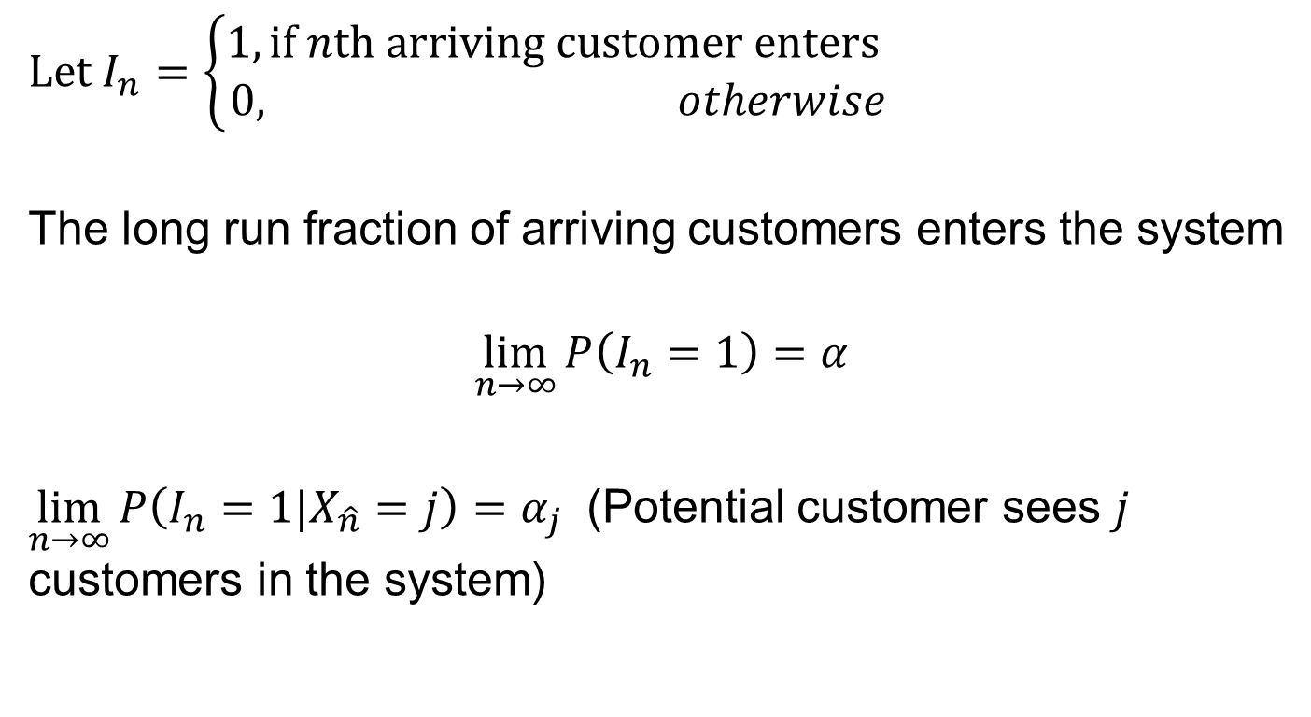
Properties of General Queuing Systems
Let $I_{n}=\left\{\begin{aligned}1,\text{if} n\text{th} \text{arriving} \text{customer} \text{enters} \\ &0, otherwise\end{aligned}\right.$
The long run fraction of arriving customers enters the system
$$\lim_{n→∞}{P\left(I_{n}=1\right)=α}$$
$\lim_{n→∞}{P\left(I_{n}=1|X_{\hat{n}}=j\right)=α_{j}}$ (Potential customer sees $j$ customers in the system)

Slide 4
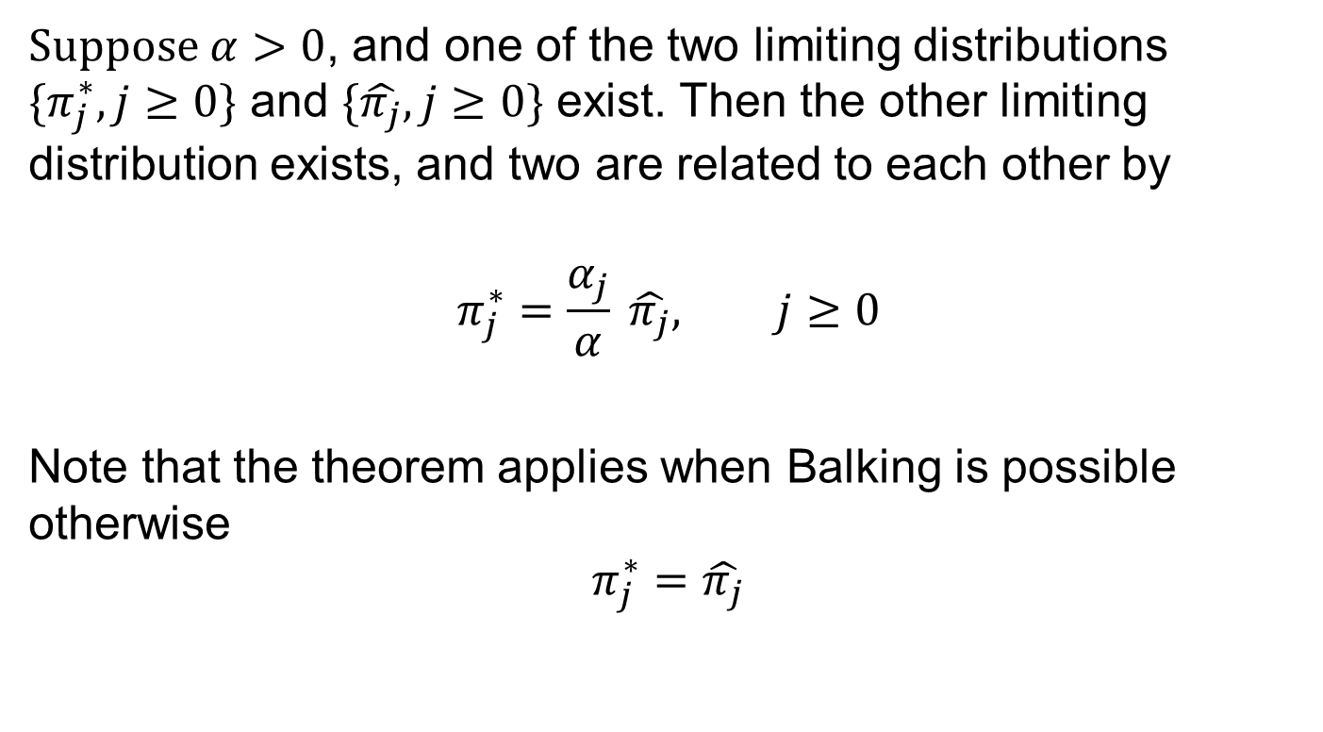
Arriving and Entering Customers
Suppose $α>0$, and one of the two limiting distributions $\{π_{j}^{∗},j≥0\}$ and $\{\hat{π_{j}},j≥0\}$ exist. Then the other limiting distribution exists, and two are related to each other by
$$π_{j}^{∗}=\frac{α_{j}}{α} \hat{π_{j}}, j≥0$$
Note that the theorem applies when Balking is possible otherwise
$$π_{j}^{∗}=\hat{π_{j}}$$

Slide 5
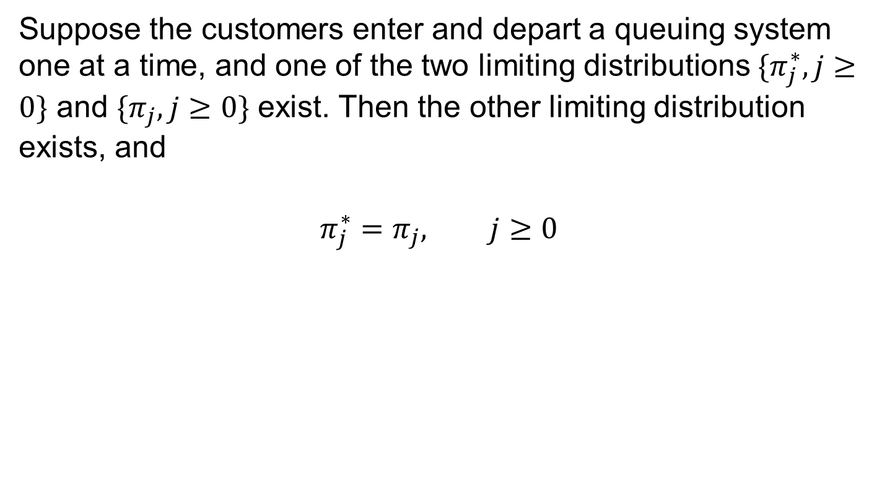
Entering and Departing Customers
Suppose the customers enter and depart a queuing system one at a time, and one of the two limiting distributions $\{π_{j}^{∗},j≥0\}$ and $\{π_{j}, j≥0\}$ exist. Then the other limiting distribution exists, and
$$π_{j}^{∗}=π_{j}, j≥0$$

Slide 6
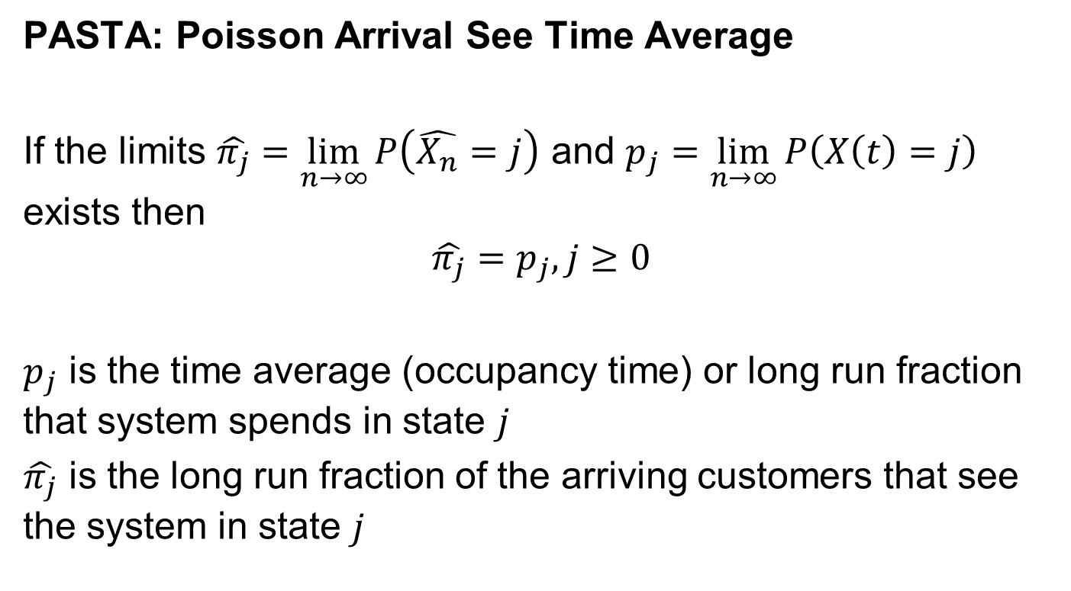
PASTA
PASTA: Poisson Arrival See Time Average
If the limits $\hat{π_{j}}=\lim_{n→∞}{P\left(\hat{X_{n}}=j\right)}$ and $p_{j}=\lim_{n→∞}{P\left(X\left(t\right)=j\right)}$ exists then
$$\hat{π_{j}}=p_{j}, j≥0$$
$p_{j}$ is the time average (occupancy time) or long run fraction that system spends in state $j$
$\hat{π_{j}}$ is the long run fraction of the arriving customers that see the system in state $j$

Slide 7
Workstation Congestion Study
A single machine takes 30 seconds to process with time between arrival of parts 40 seconds on the average. The area for waiting part is limited (usually 3 parts can be accommodated comfortably). The goals are the (1) the queue must remain in the available space next to the machine 90% of the time. (2) No more than 10% of parts should have to wait more than 1 minute.
Lets Brainstorm
Can we model it as a M/M/1 queue?

